Slide 1
The Next Big Sound:
Using Data Science to Predict Hit Songs
By: José Cacho

Slide 2

Can we predict hit songs *before* they chart on the Billboard?
Record labels spend millions of dollars looking for the next big sound and then promoting their prospective musicians heavily
Historically done by ‘feel’ - with scouts
Can we provide a data-based approach to this process?

Slide 3

Data Collection
290,000 songs
~285,000 “non-hits”
~5,000 “hits” from the Billboard Top 100 charts
Used Spotify’s API to collect 13 acoustic features for each song
E.g. ‘danceability’, ‘energy’, ‘liveness’
SMOTE to upsample “hits”

Slide 4

Data Cleanup
Removals
Songs from 1950-1963 and from 2016-2019, as my “hits” dataset did not contain any songs from this time period
Karaoke versions
Mismatches between the track and Spotify’s API

Slide 5
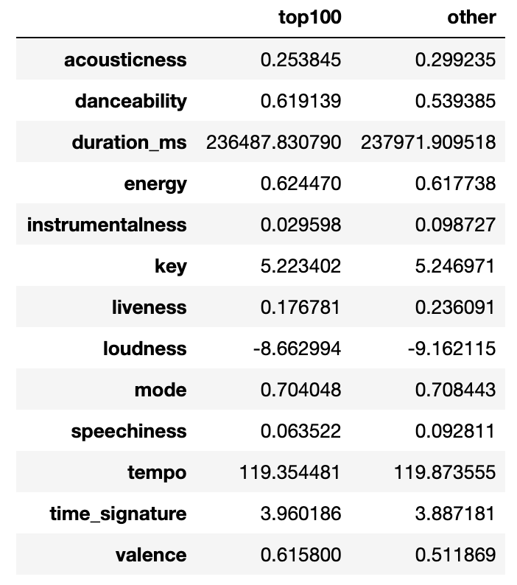
Data Analysis
To the naked eye, no major differences

Slide 6
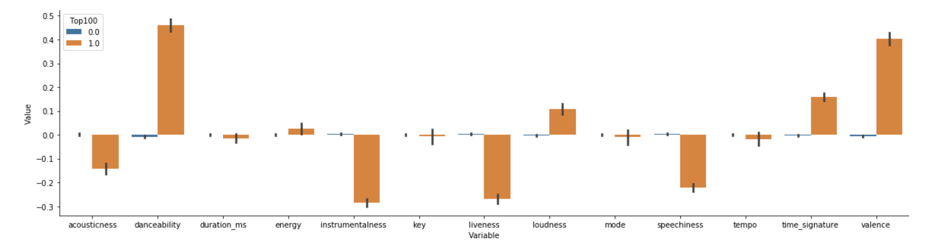
Data Analysis
However, when scaled...

Slide 7
Modeling
Train/Test split of 75/25
8 total models:
Logistic Regression
KNN
Decision Tree
Bagging
Random Forest
AdaBoost
Gradient Boosting
Voting Classifier

Slide 8
Results
Bagging
98.6%
Test Accuracy

Slide 9
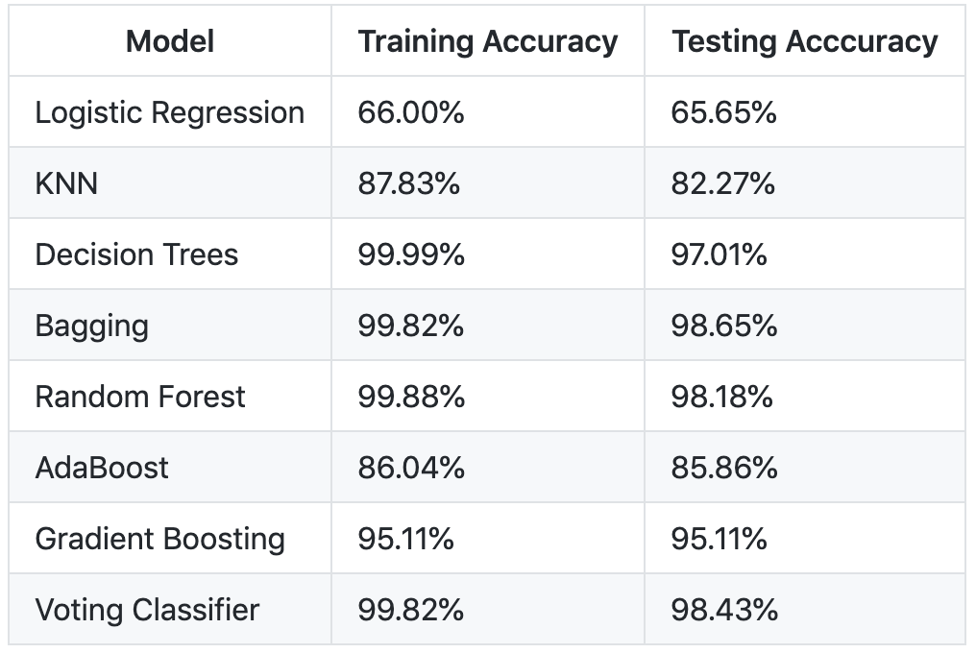
Results

Slide 10
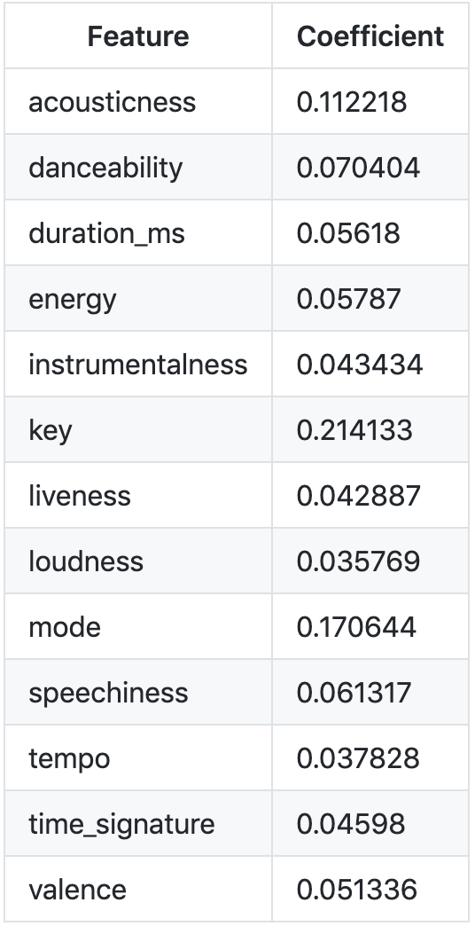
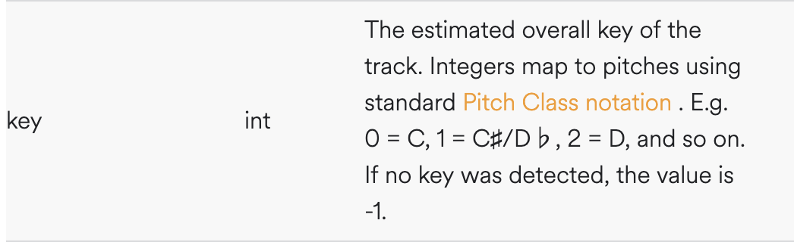
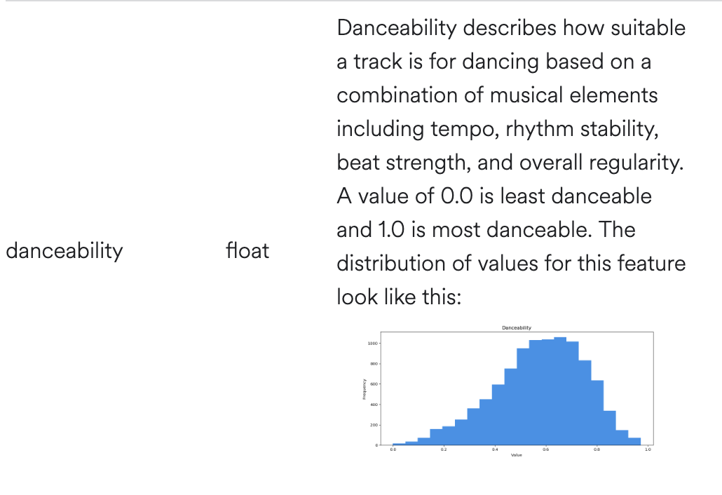
Results

